Slide 1
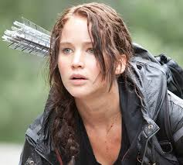
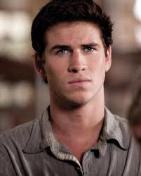
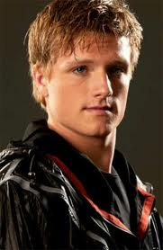
Starter
Brainstorm adjectives to describe Katniss, Peeta and Gale, from what we have read so far:
Katniss | Gale | Peeta
Independent | Strong | Quiet

Slide 2
Your task
How is the character of…….presented in the first part of the novel?
Choose between:
Katniss
Peeta
Gale
By the end of the lesson, you will have written a developed PEE/PEA response to this question. Decide which character you would like to write your response about!

Slide 3
Quote gathering
Start gathering quotes about your character.
Once you have found some quotes, select three of these and write a simple comment for each about what it reveals about their character.
“…”

Slide 4
Starter
Pick a quotation from last lesson.
Explode a word!
e.g. “I stalked out of the place in the most disrespectful manner possible.”
Shows Katniss’ attitude.
Bold and sassy.

Slide 5

Your turn
How is the character of…….presented in the first part of the novel?
Choose between:
Katniss
Peeta
Gale
Write a PEE/PEA response to this question, based on the character you have chosen.
You should aim for three – five paragraphs.
Challenge: Can you include the effect on the reader (RR: reader’s reaction)?
Can you include the writer’s intentions (WI)?

